Slide 1
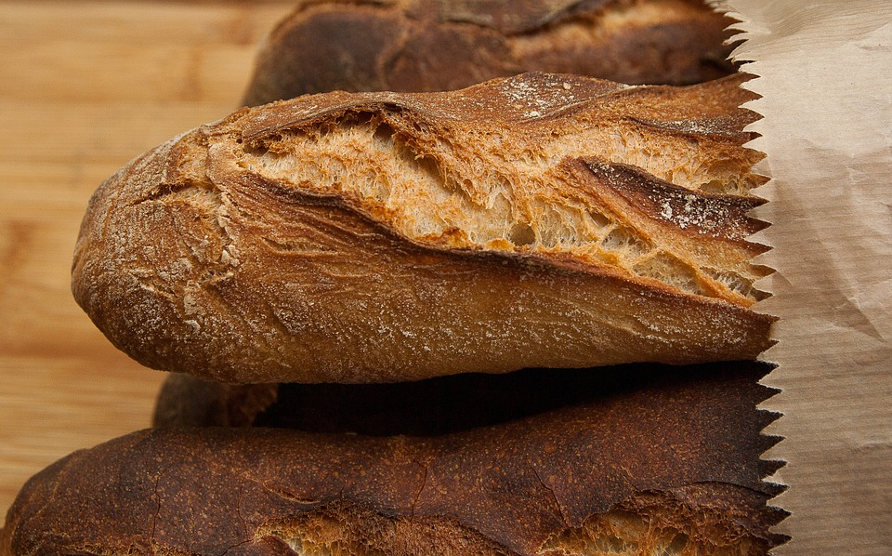
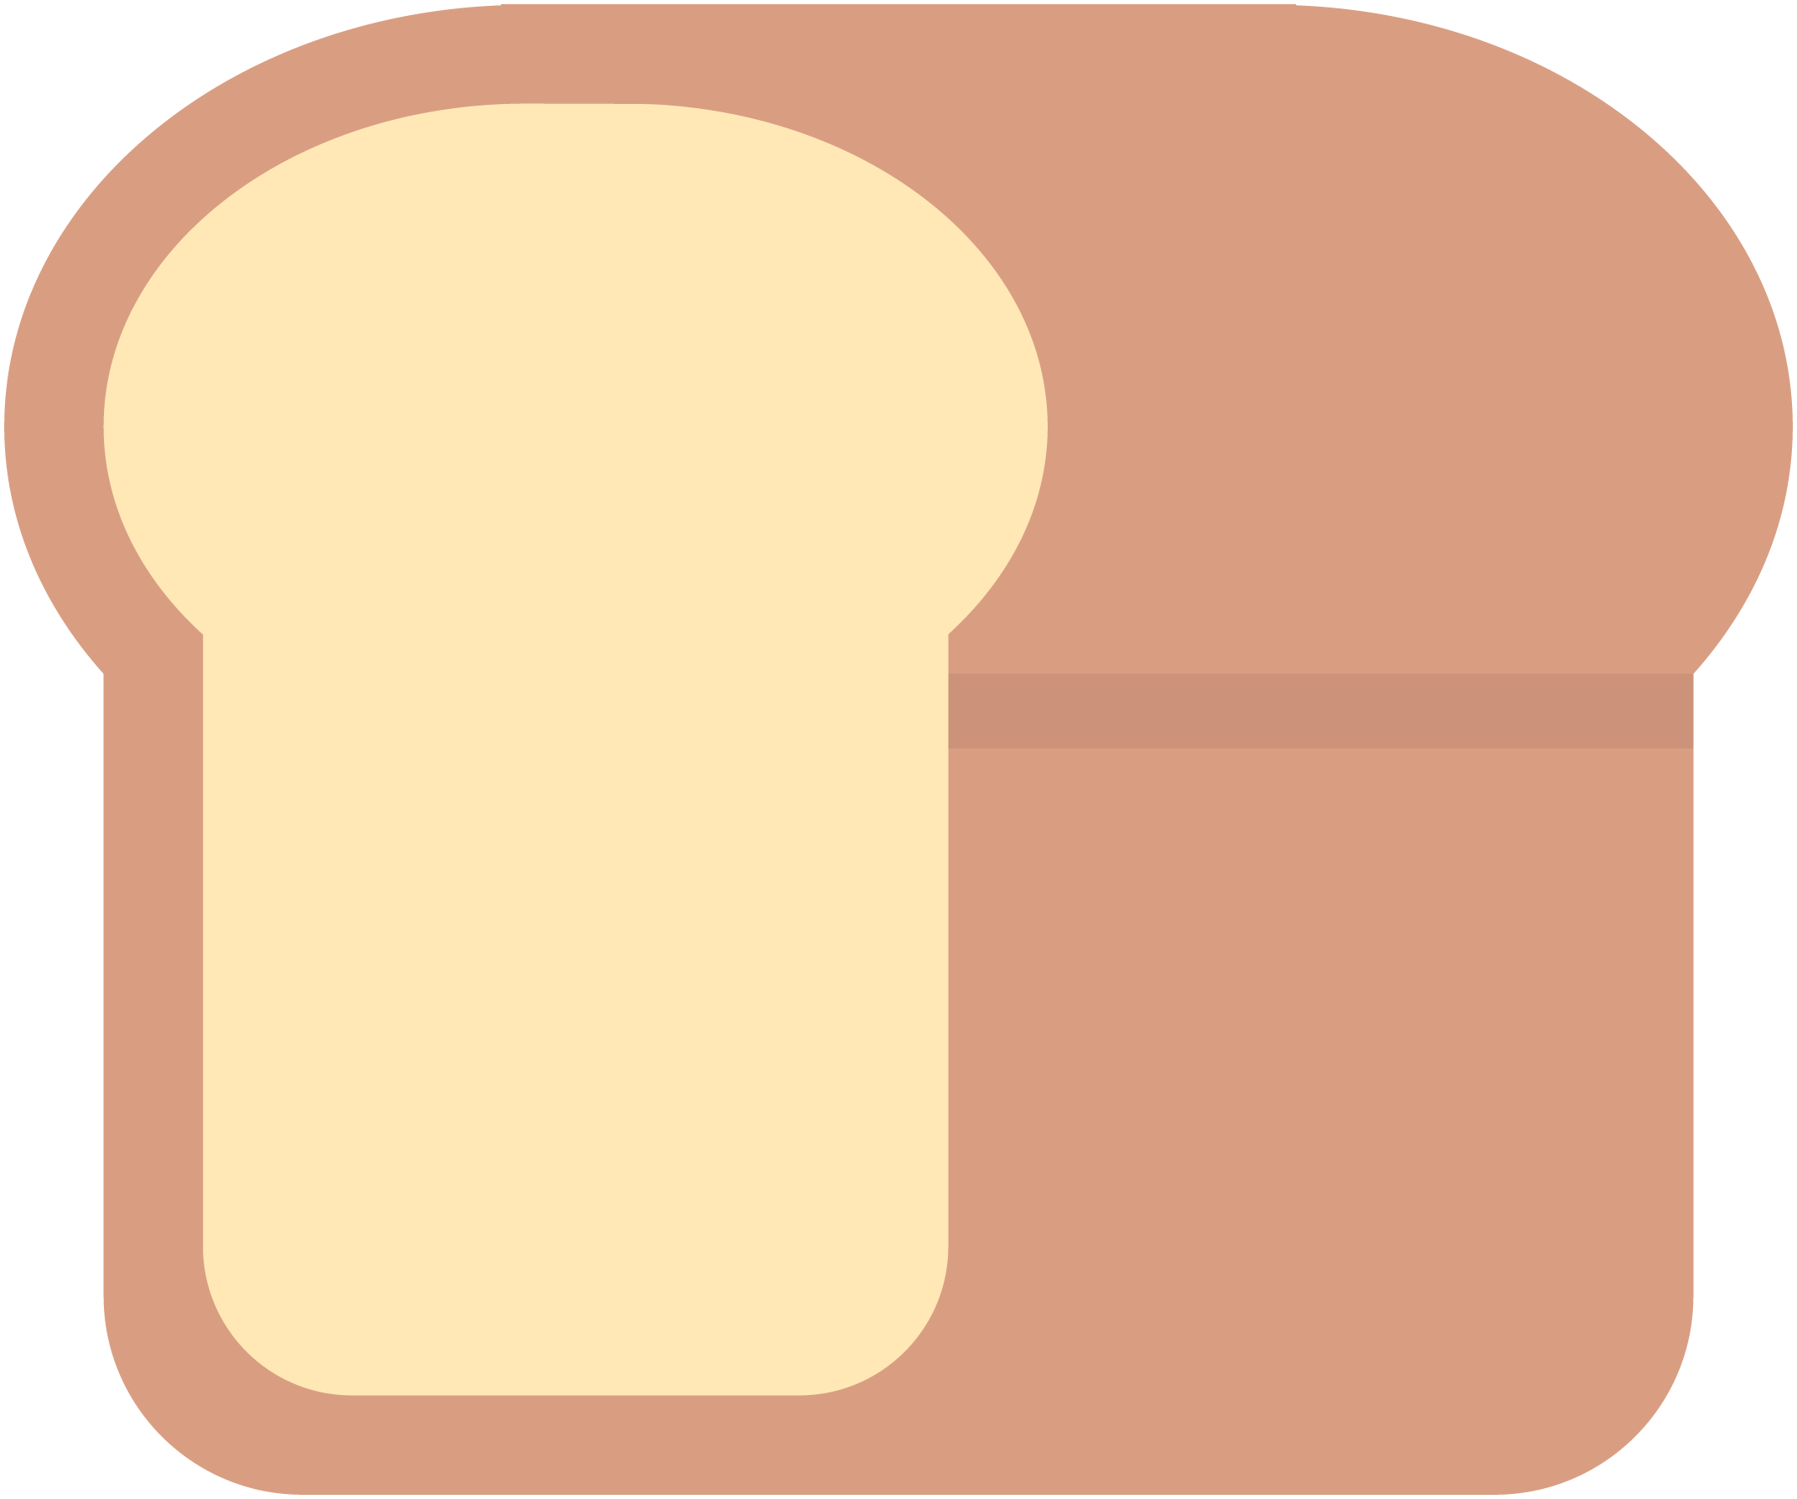
Analysis Proposal
LoafGo
Notes:
Not sure how to start off the presentation with this first slide thoughts?
Thoughts on the slide theme of the presentation?
The slides will go in the following order
Team Structure
Client Domain and problem
Solution per client need -3 slides
Technical Solution
TimeLine

Slide 2
Team
Carlos Villamar
Product Manager
Darion Wood
Architect
Samantha Burnett
UX Design Lead
Donleys Familia
Support/Tester
Jinat Rezwana
Support/Tester
Ali Mohamed
Support/Tester
Notes:
Here is a slide showcasing the teams structure, The roles as they stand currently are just placeholder for the presentation but it is something we need to have set in stone going forward as we finalize the scope of the project were we all will be responsible for building the system. Below are just some notes and some definitions of the roles.
Ideally I would like to place headshots of all of us next to our names
Product Owner will take the clients needs and develop a solution or a vision to meet those needs and will define them Cleary and effectively
Architecture Owner is the person who will build a technical roadmap to build the solution
UX stands for user experience
Support/Tester are the developers who will help build components of the system and test them

Slide 3
Loaf-Go Optimize & Scale
A bread baking factory based out of Long Island City with the means of onsite production and offsite deliveries to clientele across the 5 boroughs. The crux of the business revolves around 5 major clients, with 20 delivery trucks for daily operations. All record keeping is done with pen and paper.
The Problem:
Loaf-go needs to evolve their business into the 21st century
orders
Inventory of raw materials and products produced
Delivery tracking
Goal is to build a web based system in order to increase customer loyalty and expand their clientele
Notes:
Here we discuss the domain and the problem our client is facing. This slide is a little too busy for my taste may need to be changed

Slide 4
LoafGo operations
ORDERS
Order Numbers will be assigned to each order
Tracking of incoming/outgoing orders
Incoming- time the order is placed*
Outgoing-time the order is placed on the truck
Time of delivery – when does the client receive their order
Was it late or on time
Complaints/feedback per order
Notes:
*means user module only

Slide 5
LoafGo operations
Faster & More Precise Deliveries
Order ► Delivery ►Trucks
Trucks ► GPS real-time location
What orders are getting loaded onto each truck every day?
How many deliveries does each truck make every day and every week?
Notes:
Here I will suggest Barcodes are tied to the truck instead of the trays to streamline the delivery process. Here each order number will have to have a key generated based on delivery location, those keys would be tied to each truck.

Slide 6
LoafGo operations
Keeping Track of Inventory
Raw materials must be tracked
Alerts when running low
Breads produced and size

Slide 7
Scope
LoafGo will be used as a non-subscription based SaaS platform. Clients can create an account to place/view orders on your system. With this approach, its easier to scale the software to a much larger platform. Management has the choice to install the system or migrate it to a variety of hosting platforms. We would recommend Microsoft Azure or Amazon AWS.

Slide 8
Dependencies and Risks
The outcome of this project is dependent on proper installation of the ruby environment & rails framework. It would be best to install the software on a LINUX based server than any other. You’re less likely to face errors with dependencies(gems) that were originally built for LINUX only. Windows uses C++ to rebuild gem specs w/Windows headers/wrappers. The biggest risk that you might face is server failure. In certain cases, the infrastructure that houses the solution will fall victim to malicious hacks, power outages or onsite maintenance blunders.

Slide 9
Project Delivery
Deliverables
The following deliverables will be delivered after project completion
Software Installation files
Project documentation (Embedded YML)
User manual
Notes:
Agile Process This methodology was developed for projects that require both speed and flexibility. The process is broken down into “sprints”- short cycles for delivering certain features, functions or designated milestones. Agile sprints may be better suited to projects when there isn’t a need for tight controls or real-time communication between team members. But it does require a team that’s motivated and can approach a variety of tasks. Agile is iterative; team members must be capable of rapid adaptation with each new sprint.
What process are we using ?
How are we going to build the system from a technical based system-langauges, scalability etc.
discuss how would we reduce human error?

Slide 10
LoafGo Development TimeLine
Phase 1: RSpec Tests / Model Design / Db Implementation
Phase 2: RSpec Tests/ Refinement / Design / Implementation
Phase 3: Refinement / Acceptance Tests / Design
Project Completion Estimate Date: May 2018
Notes:
Mid May?

Slide 11
Feasibility Analysis – Cost Benefit Analysis
We can divide the cost into a few categories
Development & Purchasing Costs
Installation & Data entry cost
Enter old data into system
Operational cost
Database design and architecture
Maintenance of the system
Project Development Cost
Reason | Price
Other software cost | $20,000
System Analysis cost | $150,000
Programmers | $450,000
Database Architecture | $180,000
Software Design | $190,000
Total | $990,000

Slide 12
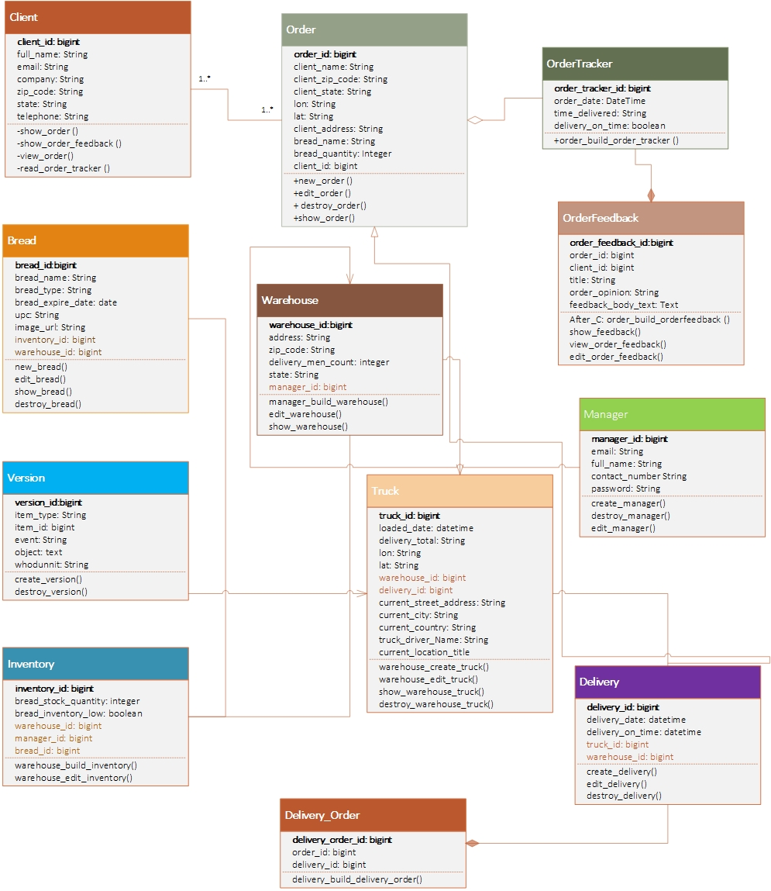
LoafGo Class UML

Slide 13
Thank you for joining us!

